Slide 1
ACA: Section 6055 and 6056 Health Coverage Reporting
The session will begin shortly
Sound should come through your speakers when the session begins
Verify that the volume is turned up on your computer
You can listen through your computer or over the phone
If there is no sound on your computer or you would like to call in directly, use the following information:
Session phone number: (877) 668-4493
Access code: 923 248 560

Slide 2
ACA: Section 6055 and 6056 Health Coverage Reporting
Presented by Erica Storm, Esq. and Becca Kopps, Esq.

Slide 3
Introduction

Slide 4
Today’s Presenters
Erica Storm, Esq.
Employment and benefits attorney
Expertise in Affordable Care Act and other health plan compliance issues
Becca Kopps, Esq.
Employment and benefits attorney
Focuses primarily on Affordable Care Act issues
Creates educational materials and compliance resources
Educates employers on compliance obligations

Slide 5
Webinar Logistics
To call in to connect to audio:
Phone number: 1-877-668-4493
Access code: 923 248 560
We welcome your questions at any time!
Questions will be addressed at the end of the session.
Select Q&A and choose “Send to All Panelists” to submit your questions.

Slide 6
Today’s Agenda
Overview of the Section 6055 and 6056 reporting requirements
Section 6055 Reporting
Section 6056: Reporting entities
Section 6056: Information to be reported
Section 6056: Methods of reporting

Slide 7
Section 6055 and 6056 Overview

Slide 8
Reporting Overview
 | Section 6055 | Section 6056
Applies to: | Providers of minimum essential coverage (MEC) | Applicable large employers (ALEs)
Requires reporting entities to: | File information with the IRS Provide statements to covered individuals | File information with the IRS Provide statements to full-time employees
Purpose is to help: | IRS administer the individual mandate and determine eligibility for subsidies Individuals show compliance with the individual mandate | IRS administer the employer shared responsibility rules
Self-funded plan sponsors that are ALEs must report under both sections, but will use a combined reporting method

Slide 9
Reporting Deadlines
Rules effective for 2015 coverage
2015 coverage information will be reported in 2016
Employers must collect information during 2015
IRS Returns
Annual Deadline: Feb. 28 (March 31, if filed electronically)
Individual Statements
Annual Deadline: Jan. 31
For 2015: Feb. 29, 2016 (March 31, if filed electronically)
For 2015: Feb. 1, 2016
May be furnished electronically if requirements are met

Slide 10
Electronic Reporting
IRS Returns
Electronic filing is required for reporting entities that file 250 or more individual statements per calendar year
Individual Statements
General rule: provide statements on paper by mail to last known permanent address (or temporary address)
Applies separately to each type of individual return (Forms 1095-B or 1095-C)
Electronic filing is OPTIONAL for other reporting entities
Statements MAY be furnished electronically if consent requirements are met

Slide 11
Required Forms
ALEs sponsoring self-insured plans
Form 1095-C:
Part I, Part II and Part III
Form 1094-C
ALEs sponsoring insured plans
Form 1095-C:
Part I and Part II only
Form 1094-C
Non-ALEs sponsoring self-insured plans
Form 1094-B
Form 1095-B
Non-ALEs sponsoring insured plans are not required to report under either Section 6055 or Section 6056

Slide 12
Who Reports What?
6055:
Self-insured non-ALEs report information about all covered individuals
6056:
ALEs report information about all full-time employees
6055 & 6056:
Self-insured ALEs report information about all full-time employees AND covered individuals

Slide 13
Penalties
Information Returns
Failure to timely file or include all required information
Including incorrect information
Individual Statements
Failure to timely furnish or include all required information
Including incorrect information on the statement
June 29, 2015: The Trade Preferences Extension Act
Increased penalties beginning for returns filed in 2016

Slide 14
Penalty Amounts
Penalty Type | Per Violation |  | Annual Maximum |  | Annual Max for Small Employers*
 | Old | New | Old | New | Old | New
General | $100 | $250 | $1.5 million | $3 million | $500,000 | $1 million
Corrected within 30 days | $30 | $50 | $250,000 | $500,000 | $75,000 | $175,000
Corrected after 30 days and before Aug. 1 | $60 | $100 | $500,000 | $1.5 million | $200,000 | $500,000
Intentional Disregard | $250+ | $500+ | None |  | N/A
*For purposes of the penalty maximum, a small employer is one that has average annual gross receipts of up to $5 million for the most recent three taxable years

Slide 15
Short-term Relief from Penalties
Penalties will not be imposed on reporting entities that can show good faith efforts to comply
Relief Available
Incorrect/incomplete information reported in 2016 related to 2015 coverage
Failure due to reasonable cause (IRS discretion)
Relief NOT Available
No good faith effort to comply
Failure to timely file information return or furnish statement

Slide 16
Section 6055 Reporting

Slide 17
Who is Required to Report?
Any person that provides minimum essential coverage to an individual:
Government-sponsored programs: the executive department or agency of a governmental unit that provides coverage under the government-sponsored program
Insured plans: the health insurance issuer (not the employer)
Self-insured group health plans: the plan sponsor
Eligible employer-sponsored coverage (including insured and self-insured plans, COBRA coverage and retiree coverage)
MEC does NOT include:
“Supplemental coverage” such as HRAs, HSAs, coverage at on-site medical clinics or Medicare Part B
Minimum Essential Coverage:
Individual health coverage (including Exchange/Marketplace plans)
Government programs (including Medicare Part A, Medicaid, CHIP and TRICARE coverage)

Slide 18
Self-Insured Plan Sponsors
If the plan is… | The plan sponsor is…
Maintained by a single employer | The employer
Maintained by more than one employer (but not a multiemployer plan under ERISA) | Each participating employer (without application of aggregation rules)
A multiemployer plan (as defined in ERISA) | The board of trustees, or other similar group of representatives of the parties who establish or maintain the plan
Maintained solely by an employee organization | Employee organization
Sponsored by some other entity | The person designated by plan terms or, if no person is designated, each entity that maintains the plan

Slide 19
Forms for 6055 Reporting
Form No. | Form Name | Used to:
1094-B | Transmittal of Health Coverage Information Returns | Transmit Forms 1095-B to the IRS
1095-B | Health Coverage Statement | Report information to the IRS and individuals About individuals who are covered by minimum essential coverage and are therefore not liable for the individual shared responsibility payment
2014 Reporting
Forms and instructions available
2015 Reporting
Draft forms issued June 16, 2015
For voluntary filing
Minor changes were made
2015 instructions have not been released

Slide 20
Form 1094-B (Transmittal Form)
Required Information
Employer name, EIN, address
Contact person’s name and telephone number
Total number of Forms 1095-B submitted with transmittal

Slide 21
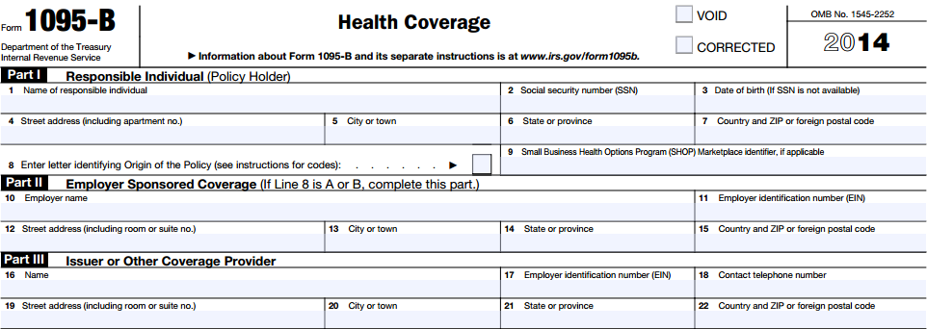
Form 1095-B (Health Coverage)
Complete one Form 1095-B for each responsible individual
Required Information
Part I: Responsible Individual | Name, SSN (or DOB), address Policy origin/SHOP identifier
Part II: Employer Sponsored Coverage | Name, EIN, address
Part III: Issuer or Other Coverage Provider | Name, EIN, address, phone number

Slide 22
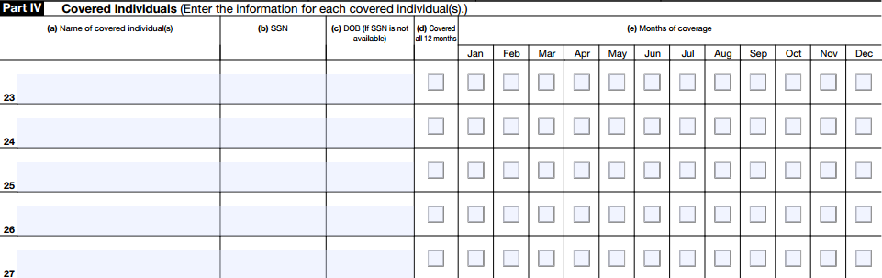
Form 1095-B (Health Coverage)
Covered Individuals
Name of covered individual
SSN (or DOB)
Whether covered for all 12 months of the year
Months covered (if not all 12 months)

Slide 23
Example
Company A provides a self-insured major medical plan for its employees
John enrolls himself and his wife in the self-insured plan for coverage for the full 2014 calendar year, beginning Jan. 1, 2014
John and his wife have a baby on June 15, 2014, and enroll the baby in the self-insured plan for coverage beginning on the birth date

Slide 24
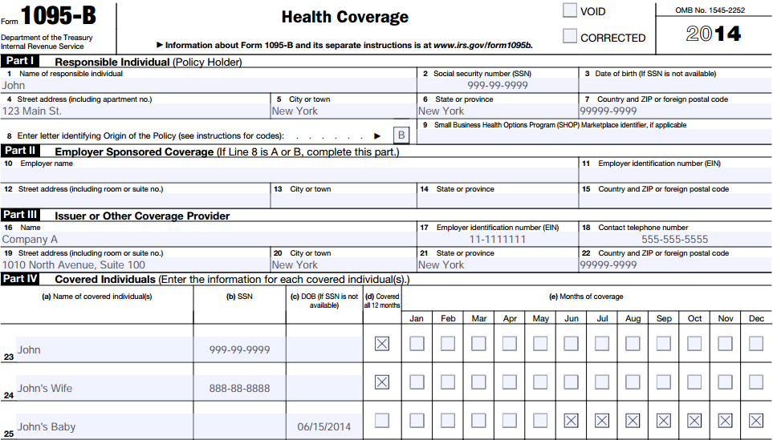
Example

Slide 25
Section 6056: Reporting Entities

Slide 26
Who is Required to Report?
Applicable large employers (ALEs) that are subject to the employer shared responsibility provisions
Definition
An employer that employed, on average, at least 50 full-time employees during the prior calendar year
Status
Locked in for each calendar year
Commonly-owned companies
Treated as a single employer
Includes full-time equivalent employees
Special rules for seasonal workers
Can use 6+ month periods for 2015 status
Based on prior year data
Determined under IRC section 414 (controlled group and affiliated service group rules)
Each member of the group is responsible for its own reporting

Slide 27
Full-time Employee
Full-time employee
Employed on average at least 30 hours of service per week (130 hours in a calendar month)
Full-time equivalent employee (FTE)
Hours of service for PT employees (up to 120 hours/person per month)
Divide by 120
Result = number of FTE employees for the month

Slide 28
Reporting for Medium-Sized ALEs
All eligible ALEs certify that they:
Employ a limited workforce
Did not reduce workforce size or overall hours of service to satisfy workforce size condition
Did not eliminate or materially reduce the health coverage (if any) offered as of Feb. 9, 2014
Medium-sized ALEs eligible for the one-year delay will still report under Section 6056 for 2015

Slide 29
Section 6056: Information to be Reported

Slide 30
Forms for 6056 Reporting
Form No. | Form Name | Used to:
1094-C | Transmittal of Employer-Provided Health Insurance Offer and Coverage Information Return | Report summary information for each employer to the IRS Certify eligibility for transition relief (including medium-sized employer delay) Transmit Forms 1095-C to the IRS
1095-C | Employer-Provided Health Insurance Offer and Coverage | Report information about each employee Satisfy combined 6055 and 6056 reporting requirements (for ALEs with self-funded plans)
2014 Reporting
Forms and instructions available
2015 Reporting
Draft forms issued June 16, 2015
For voluntary filing
Minor changes were made
2015 instructions have not been released

Slide 31
Minimum Value (MV) Coverage
To provide MV, the plan’s share of total allowed costs of benefits provided under the plan must be at least 60 percent of those costs

Slide 32
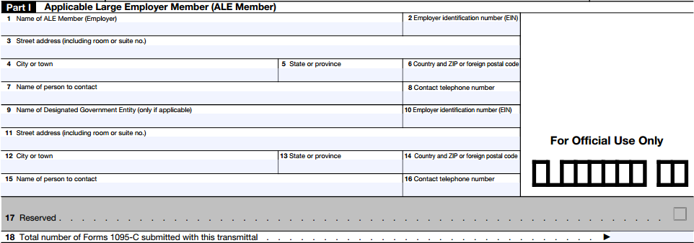
Form 1094-C (Transmittal Form)
Part I: Applicable Large Employer Member (ALE Member)
Contact information for employer and contact person
Number of Forms 1095-C submitted with the transmittal

Slide 33
Form 1094-C Part II
Part II: ALE Member Information
Indicate authoritative transmittal
Total number of Forms 1095-C filed by/on behalf of member
Indicate member of Aggregated ALE Group. If yes, complete Part IV (names and EINs of other ALE members)
Certify eligibility for alternative methods of reporting/4980H transition relief

Slide 34
Form 1094-C Part III
Part III: ALE Member Information - Monthly
MEC Offer Indicator (Yes/No)
Full-time Employee Count for ALE Member
Total Employee Count for ALE Member
Aggregated Group Indicator
Section 4980H Transition Relief Indicator (50-99 Relief – Code A, 100 or More Relief – Code B)

Slide 35
Form 1095-C: Part I
Employer will complete one Form 1095-C for each full-time employee*
Employee | Applicable Large Employer Member (Employer)
Name SSN Address | Name EIN Address Contact phone number

Slide 36
Form 1095-C: Part II Employee Offer and Coverage
Line 14: Offer of Coverage
Enter a code indicating information regarding offer of coverage
CODE | EXPLANATION
1A | Qualifying Offer
1B | MEC providing MV offered to employee only
1C | MEC providing MV offered to employee and at least MEC offered to dependent(s) (not spouse)
1D | MEC providing MV offered to employee and at least MEC offered to spouse (not dependent(s))
1E | MEC providing MV offered to employee and at least MEC offered to dependent(s) and spouse
1F | MEC NOT providing MV offered
CODE | EXPLANATION
1G | Offer of coverage to employee who: Was not a full-time employee for any month of the calendar year and Who enrolled in self-insured coverage for one or more months of the calendar year
1H | No offer of coverage (employee not offered any health coverage or employee offered coverage that is not MEC)
1I | Qualifying Offer Transition Relief for 2015

Slide 37
Form 1095-C: Part II
Line 15–Affordability of coverage: enter cost of employee share of lowest-cost monthly premium for self-only minimum value coverage
Line 16–Section 4980H safe harbors: enter code indicating why penalty won’t apply
CODE | EXPLANATION
2A | Employee not employed during the month
2B | Employee not a full-time employee
2C | Employee enrolled in coverage offered
2D | Employee in a 4980H(b) Limited Non-Assessment Period
2E | Multiemployer interim rule relief
CODE | EXPLANATION
2F | 4980H affordability Form W-2 safe harbor
2G | 4980H affordability federal poverty line safe harbor
2H | 4980H affordability rate of pay safe harbor
2I | Non-calendar year transition relief applies
NOTE: Code 2C should be used for any month in which the employee enrolled in the coverage, regardless of whether any other code could also apply

Slide 38
Form 1095-C: Part III (Combined Reporting for Self-funded ALEs)
Employers with self-funded plans will complete one Form 1095-C for each employee who enrolls in the health coverage (whether full-time or not)
Covered Individuals
Name of covered individual
SSN (or DOB)
Whether covered for all 12 months of the year
Months covered (if not all 12 months)

Slide 39
Example
Company B is an ALE that has 89 full-time and FTE employees (40 full-time employees), and provides a fully-insured plan for its eligible employees.
Mary is a full-time employee of Company B, and was offered affordable MEC that provides MV for herself and her family members for the full 2014 calendar year
Mary enrolled herself in the coverage offered by Company B for coverage beginning Jan. 1, 2014

Slide 40
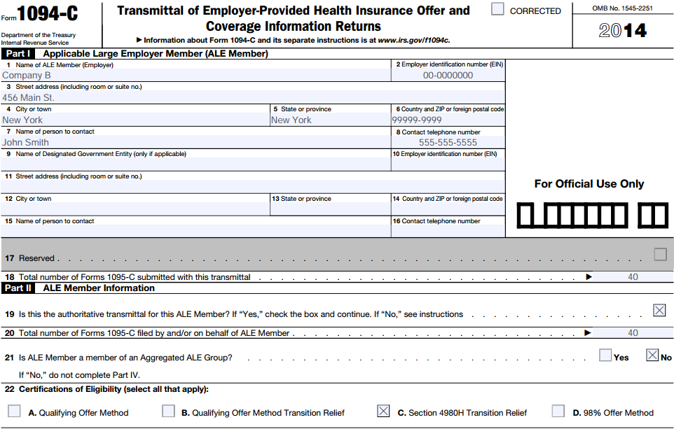
Example: Form 1094-C, Parts I and II

Slide 41
Example: Form 1094-C, Part III
Assume Company B:
Maintained a consistent workforce for the full 2014 calendar year
Offered coverage to substantially all full-time employees (and dependents) for all of 2014

Slide 42
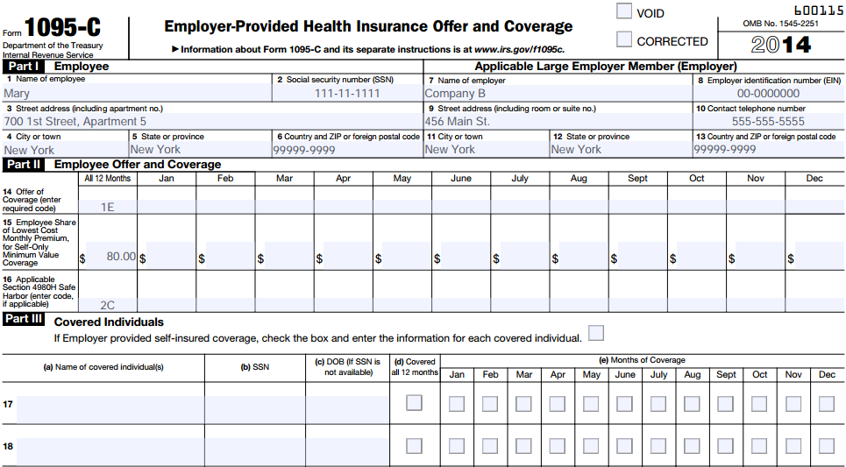
Example: Form 1095-C

Slide 43
Section 6056: Methods of Reporting

Slide 44
Methods of Reporting
General method: may be used by all ALEs for reporting to the IRS and furnishing statements to full-time employees
Alternative methods: may be used by eligible ALEs for certain employees
ALEs that are not eligible to use an alternative reporting method for certain employees must use the general method for those employees

Slide 45
General Method of Reporting
All ALEs must report information about health coverage offered to full-time employees
Including whether an offer of health coverage was made
For each full-time employee, the ALE must report:
Whether an offer of health coverage was or was not made to the employee
Applies to all ALEs whether or not they offered health coverage to full-time employees
ALEs that do not offer any coverage must report that coverage was not offered
If an offer was made, the required information about the offer
Provide information to full-time employees
A copy of Form 1095-C (or a substitute form with the same information)
Do not have to provide Form 1094-C

Slide 46
The Qualifying Offer Method
ALE must make a Qualifying Offer for all months of a year in which the employee was full-time under Section 4980H
Qualifying Offer occurs when the ALE:
Offers MEC that is affordable (based on FPL) and provides minimum value AND
Offers MEC to the employee’s spouse and dependents (if any)
If not made for all 12 months
If made for all 12 months:
Provide less detailed information on IRS returns
Provide simplified employee statements (unless enrolled in self-insured coverage)
Use the general reporting method
Use an indicator code for months that a Qualifying Offer was received

Slide 47
Reporting Using the Qualifying Offer Method
In Part II of Form 1094-C:
Certifications of Eligibility: Check box A, Qualifying Offer Method
In Part II of Form 1095-C:
Offer of coverage: enter Code 1A in either the “All 12 months” box (or all of the monthly boxes) to indicate that the employee received a Qualifying Offer for all 12 months
Employee cost: DO NOT enter a dollar amount for the employee cost for any month

Slide 48
Qualifying Offer Method: 2015 Transition Relief
General Rule:
2015 Transition Relief:
How to Report:
Use the general method to report for all employees that didn’t receive a Qualifying Offer for all 12 months
If a Qualifying Offer is made to at least 95% of full-time employees, the ALE can report simplified data for ALL full-time employees
Use the Qualifying Offer method, except:
Separate indicator codes will apply for months in which a Qualifying Offer was received or Transition Relief applies
Simplified employee statements will indicate whether the employee may be eligible for a premium tax credit and direct employees to IRS info on premium tax credits

Slide 49
Reporting Using the Qualifying Offer Method Transition Relief for 2015
In Part II of Form 1094-C:
Certifications of Eligibility: Check box B, Qualifying Offer Method Transition Relief
In Part II of Form 1095-C:
Offer of coverage: Enter Code 1A for each month in which a Qualifying Offer was received Enter Code 1I for each month in which the Transition Relief applies (i.e., each month a Qualifying Offer was not received)
Employee cost: DO NOT enter a dollar amount for the employee cost

Slide 50
The 98% Offer Method
ALE must offer affordable, minimum value coverage to at least 98% of employees and dependents reported on its Section 6056 return
Affordability based on any pay or play safe harbor method
How to Report:
Eligible ALEs do not have to specify their number of full-time employees or identify which are full-time on IRS returns
No simplified method for employee statements

Slide 51
Zywave Resources

Slide 52
Broker Briefcase Resources
HCR: Employer Reporting of Health Coverage - Code Sections 6055 & 6056
Health Care Reform: Q&As on Reporting by Health Coverage Providers (Section 6055)
Health Care Reform: Q&As on Employer Reporting of Health Coverage (Section 6056)
Penalties Increased for Section 6055 and Section 6056 Reporting Violations
Health Care Reform: Code Section 6055/6056 - What Information Must Be Reported?

Slide 53
ACA Reporting Workbooks
Section 6055 and Section 6056 Reporting Workbooks
Instructional Guides
Tutorial Videos
Marketing Materials
Updated for 2014 final forms

Slide 54
Questions?

Slide 55
Thank you!
This presentation is current as of the date presented and is for informational purposes only. It is not intended to be exhaustive nor should any discussion or opinions be construed as legal advice. Please contact legal counsel for legal advice on specific situations. This presentation may not be duplicated or redistributed without permission. © 2015 Zywave, Inc. All rights reserved.

